Slide 1

MAJOR PROJECT-2
EMPLOYEE MENTAL HEALTH SYSTEM
UNDER THE GUIDANCE OF:
Dr. ANKITA VERMA
NIKITA SINGHAL 20103117
TANUPRIYA PATHAK 20103288

Slide 2
INDEX
SNO. | TOPICS | Pg No
1 | OBJECTIVE | 3
2 | WHY MENTAL HEALTH CHATBOT | 4
3 | MOTIVATION BEHIND THE PROJECT | 7
4 | IMPLEMENTATION TOOLS AND LANGUAGE | 8
5 | PROJECT METHODOLOGY | 9
6 | OVERALL DESIGN OF THE PROJECT | 11
7 | KEY RESEARCH PAPERS CONSULTED | 12
8 | DATASET DESCRIPTION | 13
9 | EVALUATION METRICS | 15
10 | PROPOSED CHATBOT MODEL | 16
11 | REFERENCES | 21

Slide 3
OBJECTIVES
1. Develop an application leveraging the power of natural language processing to predict and scale mental health states based on user responses.
2. Incorporating a simple conversational agent using natural language processing techniques.
3.Song Recommendation based on user’s mood.

Slide 4
Mental Health
Mental health refers to a person's emotional, psychological, and social well-being. It encompasses one's thoughts, feelings, and behaviors and plays a crucial role in how individuals handle stress, relate to others, and make choices. Good mental health is characterized by a state of balance and resilience, allowing individuals to cope with life's challenges, maintain positive relationships, and achieve a sense of overall well-being. Mental health issues can range from common conditions like anxiety and depression to more severe disorders, requiring professional intervention and support. Promoting and maintaining good mental health is essential for a fulfilling and productive life.

Slide 5
Why Mental Health Chatbot?
A mental health chatbot serves a critical purpose by addressing several key challenges in the mental health landscape. Its importance lies in providing accessible, immediate, and confidential support to individuals navigating various mental health concerns. By breaking down barriers to entry, such as stigma or limited availability of traditional services, mental health chatbots empower users to seek help when needed. The anonymity they offer fosters a safe space for users to express their thoughts and emotions openly. These chatbots contribute to early intervention and prevention efforts by offering timely assistance, educational resources, and routine check-ins. Their 24/7 availability ensures continuous support, making them an invaluable tool for individuals who may be in crisis or simply seeking information. Ultimately, mental health chatbots play a crucial role in supplementing traditional mental health services, enhancing overall accessibility, and promoting positive mental well-being on a global scale.

Slide 6
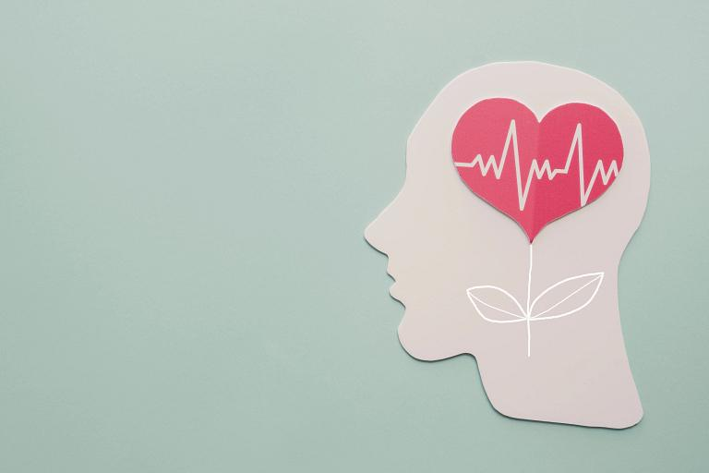
IMPORTANCE OF MENTAL HEALTH FOR EMPLOYEES
Good mental health is crucial for employees because it enhances productivity, job satisfaction, stress management, interpersonal relationships, creativity, and innovation. It also reduces absenteeism and presenteeism, supports employee retention, contributes to a positive company culture, and ensures legal and ethical compliance.
Mental health is not only vital for the well-being of individual employees but also has a substantial impact on the overall success and health of an organization. Employers who invest in promoting and supporting their employees' mental health can experience numerous benefits, including increased productivity, job satisfaction, and retention, while also fulfilling their ethical and legal responsibilities.

Slide 7
MOTIVATION BEHIND THE PROJECT
Employees are the most important asset of any organization and so to take care of their mental health is important. Motivation for creating a project targeting the mental health of employees stem from genuine concern for employee well-being, the desire to improve productivity and the recognition of the positive impact on company culture. Creating a supportive mental health environment can help retain valuable employees. Many organizations recognize the importance of mental health and contribute positively to society by prioritizing these requirements .
Mental health chatbots provide immediate and accessible support, breaking down barriers to seeking help. Users can access support at any time, overcoming limitations associated with traditional healthcare services' availability.
Chatbots offer a level of anonymity that can encourage individuals to express their thoughts and feelings openly. This sense of privacy can be crucial for those who may feel stigmatized or hesitant to discuss their mental health concerns with others.
By providing support and information in real-time, mental health chatbots can contribute to early intervention and prevention efforts. Timely assistance can help address issues before they escalate into more significant mental health challenges.

Slide 8
IMPLEMENTATION TOOLS AND LANGUAGE
LANGUAGE USED
Python 3.11.4
IMPLEMENTATION TOOLS
NLTK 3.8.1
Scikit-learn 1.2.2
Keras 2.15.0

Slide 9
PROJECT METHODOLOGY
Part 1: Prediction of mental health states and assessment of their severity by answering questions.
Part 2:Mental Health Chatbot
Intent Recognition and Text Processing:
A pre-trained neural network model analyzes the user's input and predicts the most likely intent based on patterns learned during training.
The input is tokenized into individual words, and each word is lemmatized to its base form. This processed input is then used to create a "bag of words" representation.
The "bag of words" is a binary vector indicating the presence or absence of specific words in the user's input. This representation allows the model to make predictions based on word patterns.

Slide 10
PROJECT METHODOLOGY
Model Prediction:
Utilizes a pre-trained neural network to predict the intent class associated with the user's input. The bag of words is fed into the neural network model ('chatbot_model.h5'), which outputs a probability distribution over the possible intent classes. The model selects the intent with the highest probability as the predicted intent.
Response Generation:
Provides contextually relevant responses based on the recognized intent. The chatbot selects a random response from a set of predefined responses associated with the predicted intent in the 'intents.json' file. This randomness adds variability to the bot's replies.
Part 3: Music Suggestion based on mood
Apply nlp algorithms for sentiment analysis on user responses and based on the mood detected suggest songs based on genres corresponding to user’s mood.

Slide 11
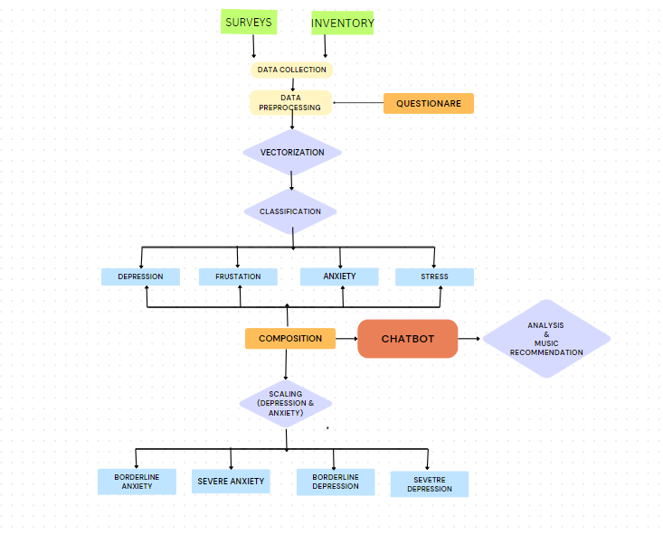
Overall Design of the Project

Slide 12
SOME KEY RESEARCH PAPERS CONSULTED
Authors | Topic | Key Characteristics
Shivam Sakore, Pratik Jagdale, Mansi Borawake, Ankita Khandalkar | Music Recommender System Using ChatBot | This paper proposes a chatbot that recommends music based on user's emotional state, detected through supervised machine learning (SVM) and IBM Tone Analyzer API.
Anusha , Dr. Srinivasan V, | Chatbot Song Recommendation System | It utilizes the Last.fm API for song recommendations and IBM Tone Analyzer API for emotion analysis. The paper highlights the potential of AI for personalized experiences and discusses future directions for chatbot development such as recognizing mixed emotions.
Simran Chaudhari , Hrucha Malusare , Aadil Adheesh ,Mokshada Bhadavalkar ,Asma Shaikh | Chatbot with Song Recommendation based on Emotion | This paper combines machine learning (SVM, LSVM, Random Forest, Decision Tree) and deep learning LSTM for chatbot response generation. for a system that detects emotions from text and generates responses .
Abid Hassan,1M. D. Iftekhar Ali,1Rifat Ahammed,1Sami Bourouis,2and Mohammad Monirujjaman Khan | Development of NLP-Integrated Intelligent Web System for E-Mental Health | This paper proposes a web app for mental health support. It utilizes an NLP chatbot with MBTI assessment for initial user classification and offers real-time communication features like chat forums and video calls for user-to-user and user-to-psychiatrist interaction.

Slide 13
DATASET DESCRIPTION
This dataset contains a collection of conversations related to mental health. It covers various conversational styles, such as casual chats, common questions about mental health, discussions on traditional therapy, and general advice for people dealing with depression or anxiety. The main purpose of the dataset is to train a chatbot model to simulate a therapist, providing empathetic and supportive responses to those seeking emotional assistance.
To train the model effectively, the dataset includes the concept of "intents," representing the core purpose behind a user's message. For instance, if a user expresses sadness, the corresponding intent would be labeled as "sad." Each intent is accompanied by sample messages (patterns) that align with that specific intent, along with corresponding responses that the chatbot should generate. By defining multiple intents, patterns, and responses, the model learns to recognize user intentions and generate appropriate and compassionate replies.

Slide 14
DATASET DESCRIPTION
Key: "intents"
Value: This is an array containing a list of intents.
Each intent:
Key: "tag"
Value: This defines the intent category, such as “greeting” or “fact”.
Key: "patterns"
Value: This is an array containing user phrases that trigger the intent, for example, greetings like "Hi" or "Good morning".
Key: "responses"
Value: This is an array containing potential responses the chatbot can give depending on the user's specific phrase within the intent.

Slide 15
EVALUATION METRICS
Accuracy score:
Validation accuracy score is a metric used in machine learning to evaluate the performance of a model on a validation dataset. In supervised learning, a dataset is typically split into two parts: a training dataset, used to train the model, and a validation dataset, used to evaluate the model's performance on unseen data.
The validation accuracy score represents the percentage of correctly predicted labels in the validation dataset. It is calculated by dividing the number of correctly predicted labels by the total number of validation examples. A higher validation accuracy score indicates that the model is better at generalizing to unseen data and is less likely to overfit to the training data.

Slide 16
PROPOSED CHATBOT MODEL
Our project aims to create a chatbot equipped with advanced natural language processing (NLP) capabilities. This chatbot will engage employees in conversations to assess their mental state, providing valuable insights to both employees and employers. As part of its features, the chatbot will also offer music recommendations tailored to the individual's mood.
Components:
Chatbot Design : Leveraging state-of-the-art NLP algorithms, the chatbot can understand and respond to user inputs, fostering a supportive and conversational environment.
Conversation Analysis : The chatbot employs sophisticated conversation analysis techniques, including sentiment analysis and language pattern recognition.
Music Recommendation Algorithm : Integrated into the chatbot is a robust algorithm that suggests music based on the user's mood classification. Considering various genres and their impact on mood, the chatbot aims to enhance the user's emotional state through carefully curated music recommendations.

Slide 17
PROPOSED CHATBOT MODEL
User Engagement : To maintain user engagement, the chatbot incorporates strategies such as regular check-ins, personalized interactions, and feedback mechanisms. This ensures that employees feel supported and valued, contributing to a positive workplace culture.
Benefits for Employees : The project brings numerous benefits for employees, including heightened mental health awareness, personalized support, and a potential increase in overall well-being. A positive impact on job satisfaction and morale is expected.
Future Enhancements : Looking ahead, there are opportunities for further enhancements. Future iterations may involve integrating the chatbot with other wellness programs, expanding its capabilities, and refining the music recommendation algorithm for even more personalized experiences.

Slide 18
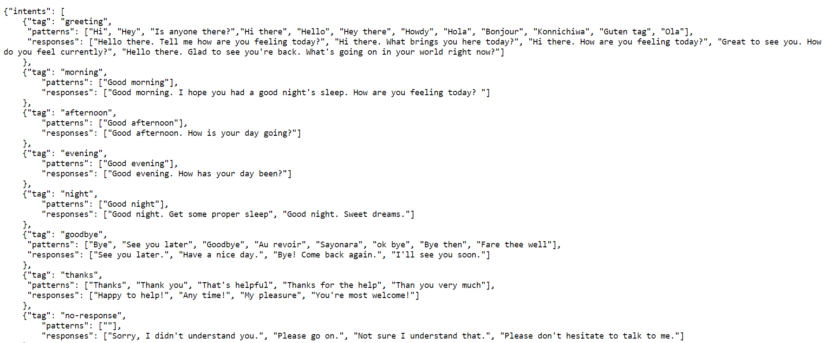
DATASET

Slide 19
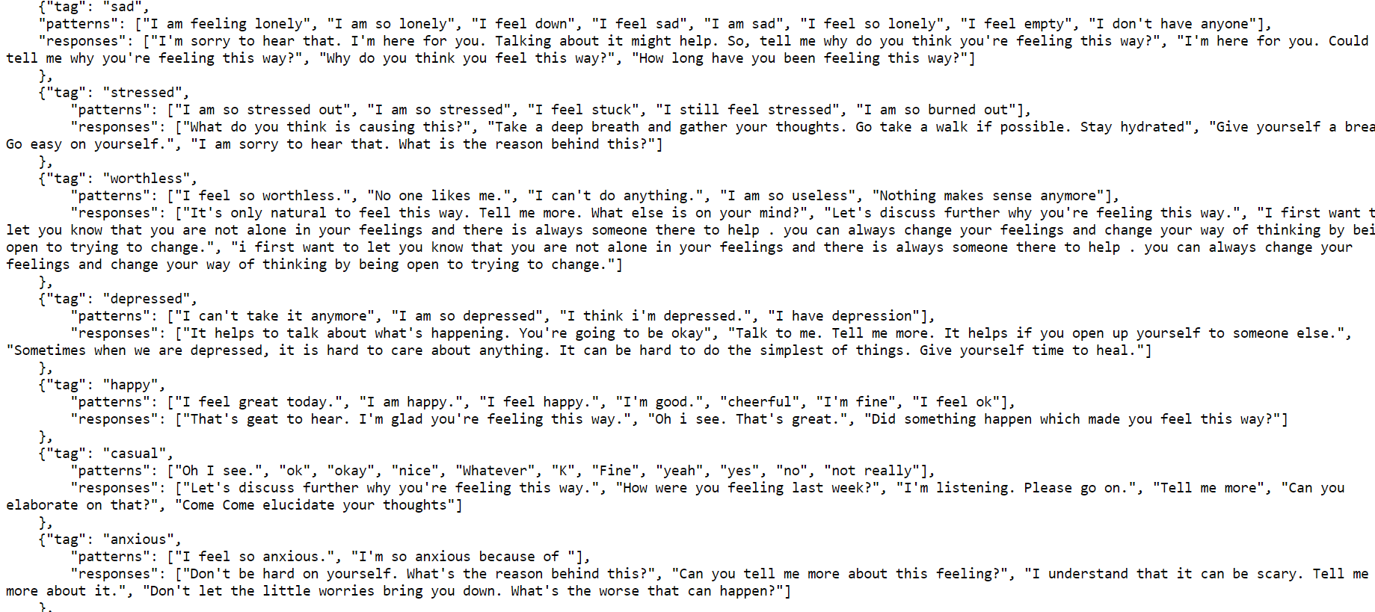

Slide 20
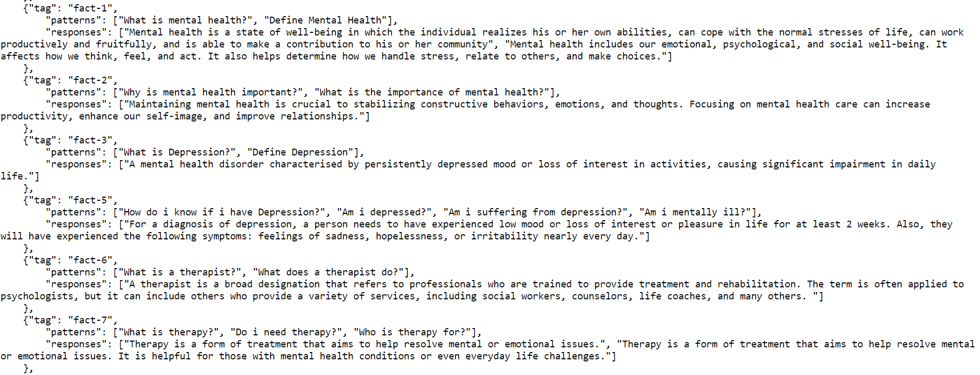

Slide 21
REFERENCES
[1]. Simran Chaudhari, Hrucha Malusare, Aadil Adheesh, Mokshada Bhadavalkar, Asma Shaikh, "Chatbot with Song Recommendation based on Emotion," International Journal of Recent Technology and Engineering (IJRTE), vol. 3, issue 5, pp. 24-26, [Online]. Available: https://ijrpr.com/uploads/V3ISSUE5/IJRPR4187.pdf
[2]. Anusha, Dr. Srinivasan V., "Chatbot Song Recommendation System," International Journal of Engineering Research & Technology (IJERT), [Online]. Available: https://www.ijert.org/chatbot-song-recommendation-system
[3]. Shivam Sakore, Pratik Jagdale, Mansi Borawake, Ankita Khandalkar, "Music Recommender System Using ChatBot," International Journal of Research in Advanced Science, Engineering and Technology (IJRASET), [Online]. Available: https://www.ijraset.com/research-paper/music-recommender-system-using-chatbot
[4]. Abid Hassan, M. D. Iftekhar Ali, Rifat Ahammed, Sami Bourouis, and Mohammad Monirujjaman Khan, "Development of NLP-Integrated Intelligent Web System for E-Mental Health," Computational and Mathematical Methods in Medicine, vol. 2021, article ID 1546343, [Online]. Available: https://www.hindawi.com/journals/cmmm/2021/1546343/

